Slide 1
K-Means Clustering

Slide 2
About
The k-means algorithm searches for a pre-determined number of clusters within an unlabeled multidimensional dataset.
It accomplishes this using a simple conception of what the optimal clustering looks like:
The "cluster center" is the arithmetic mean of all the points belonging to the cluster.
Each point is closer to its own cluster center than to other cluster centers.

Slide 3
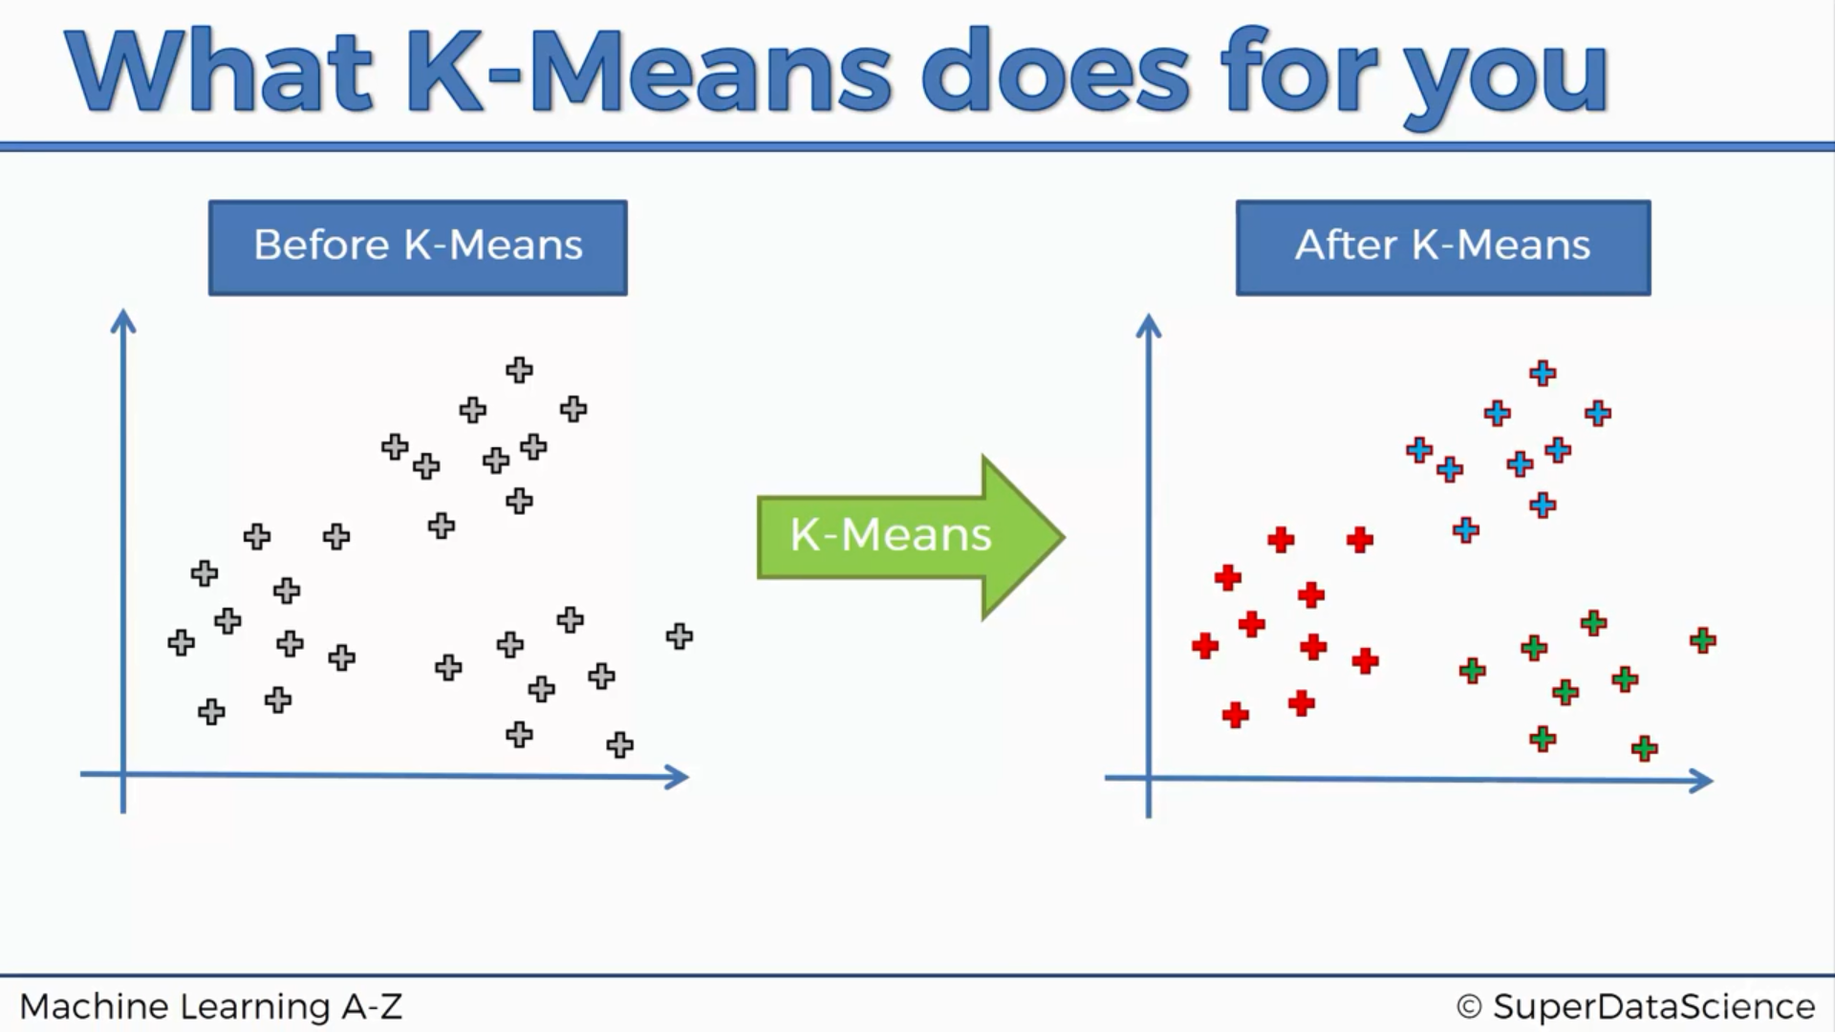
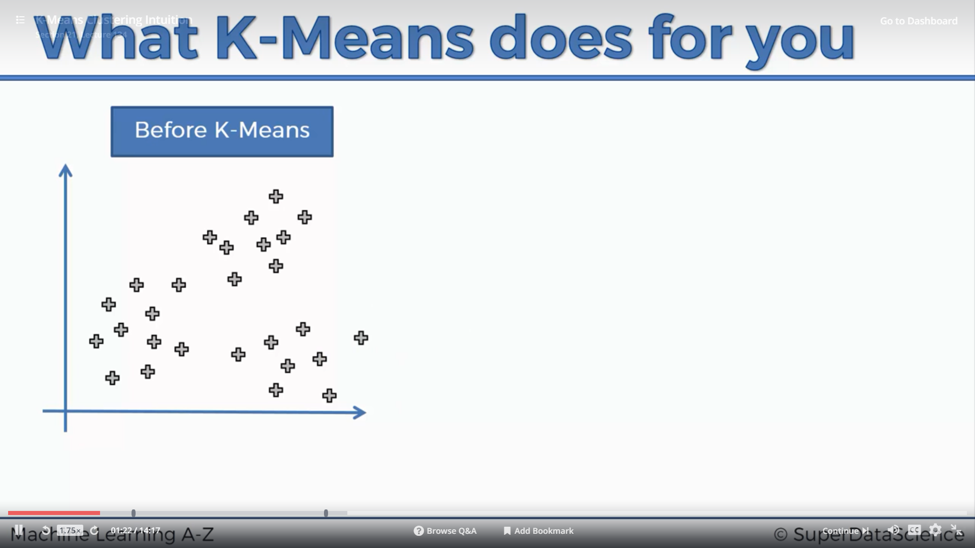

Slide 4
Steps to creating a K Means Cluster
STEP 1: Choose the number of clusters (K)
STEP 2: Randomly select K points, the centroids (not necessarily from your dataset)
STEP 3: Assign each data point to the closest centroid. This creates K clusters.
STEP 4: Compute and place the new centroid of each cluster
STEP 5: Reassign each data point to the new closest centroid. If any reassignments took place, go to STEP 4. Otherwise, go to FINISH
FINISH: The model is ready.

Slide 5
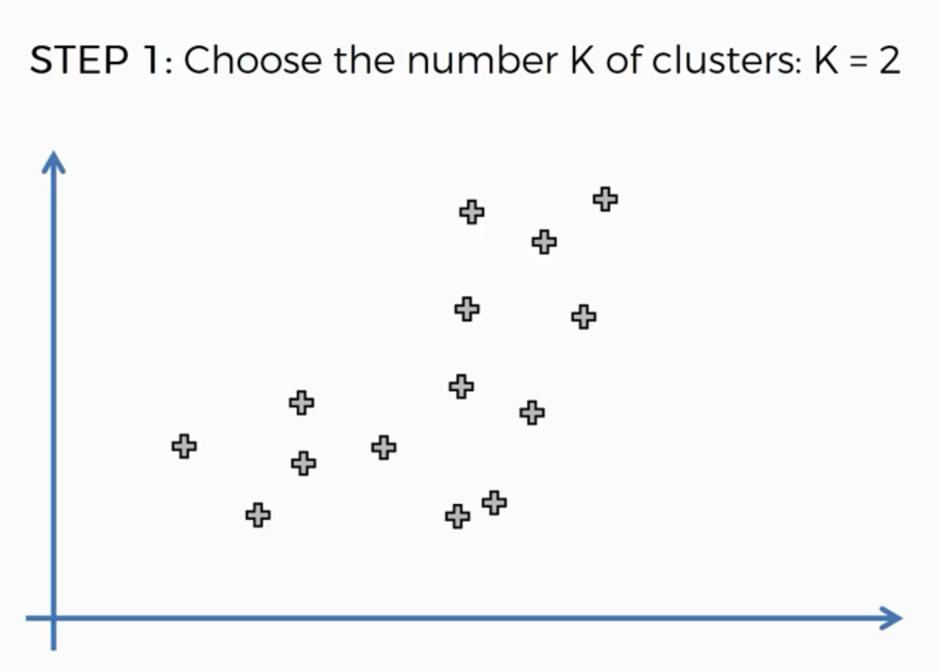

Slide 6
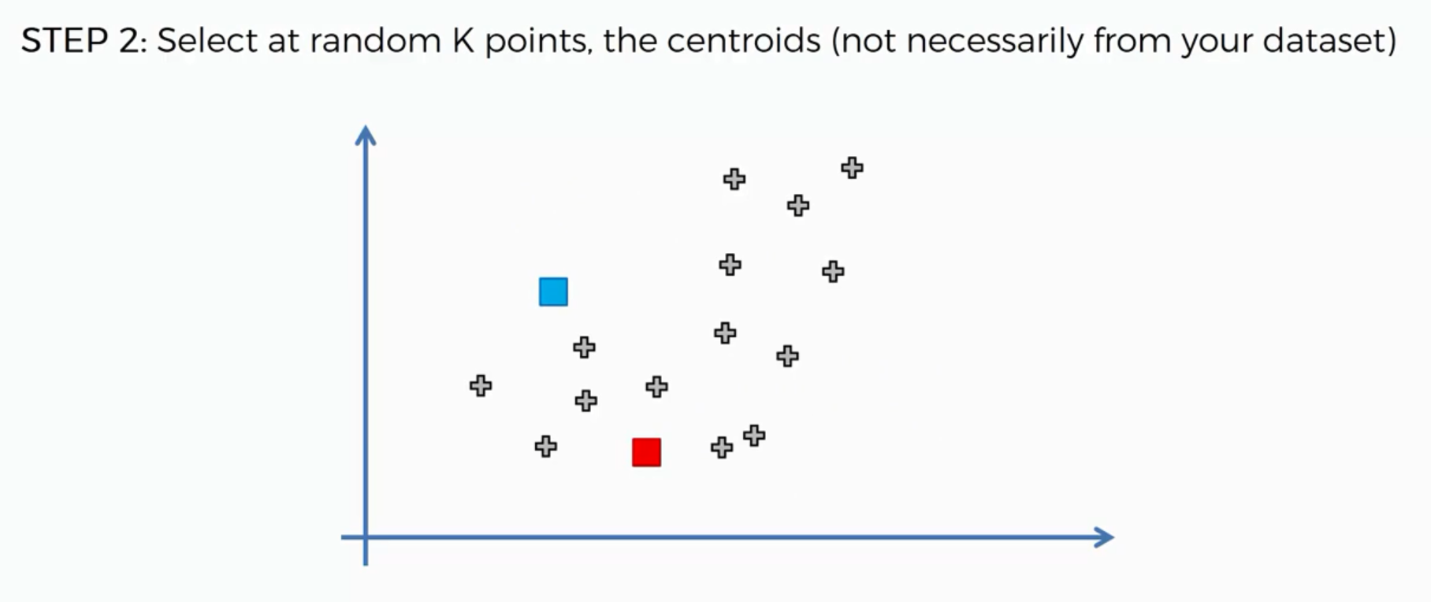

Slide 7
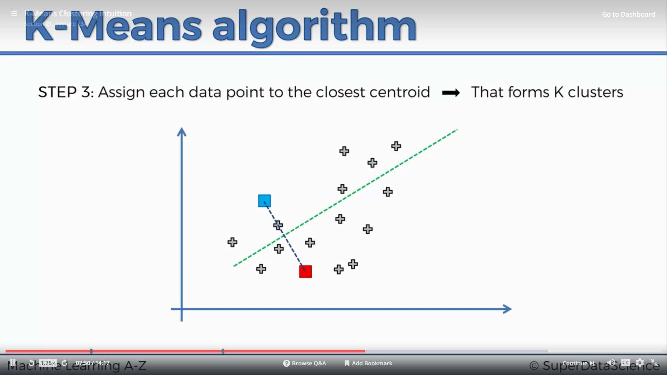
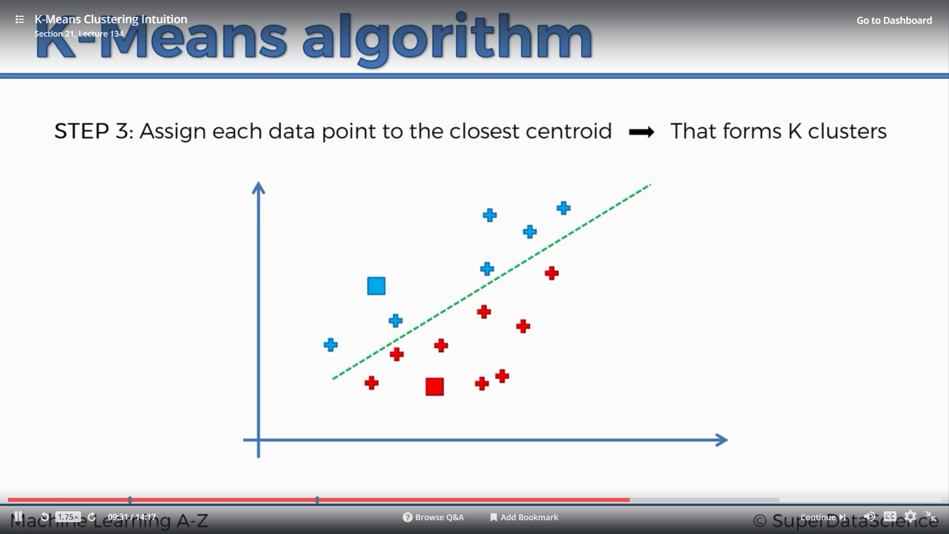

Slide 8
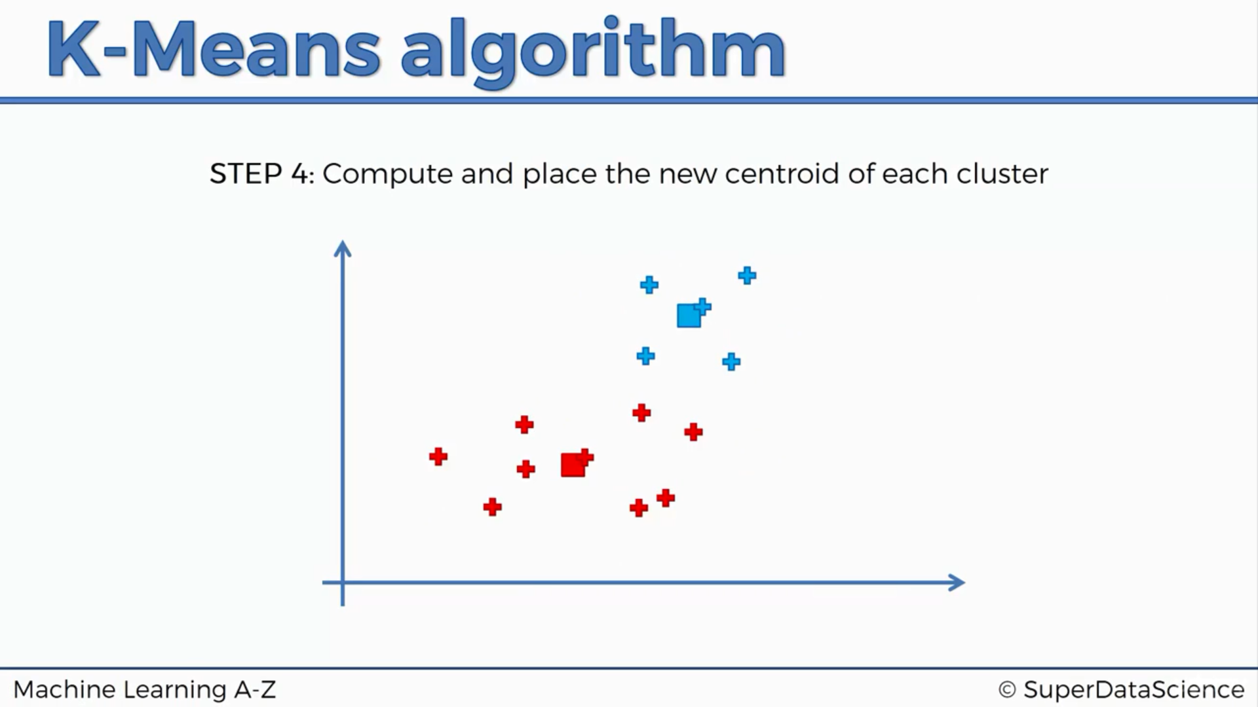
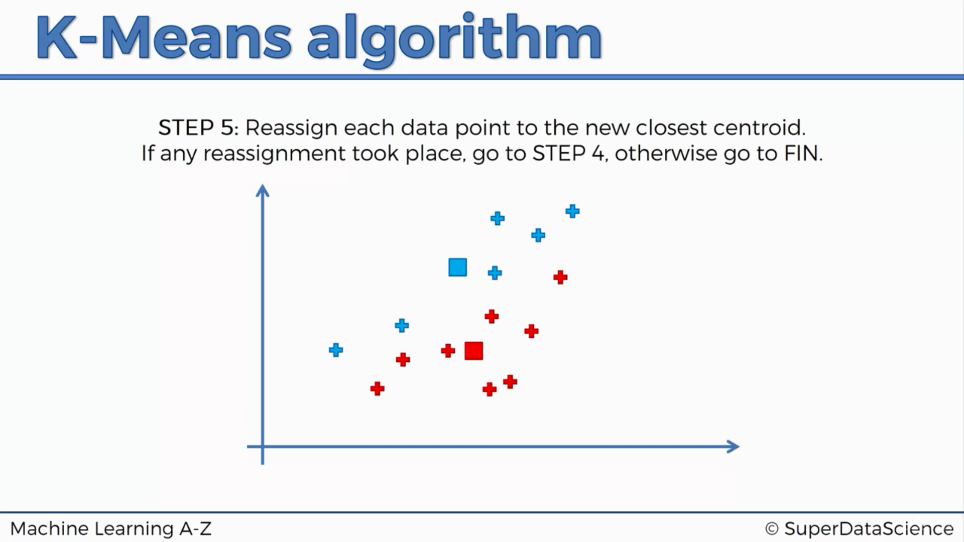
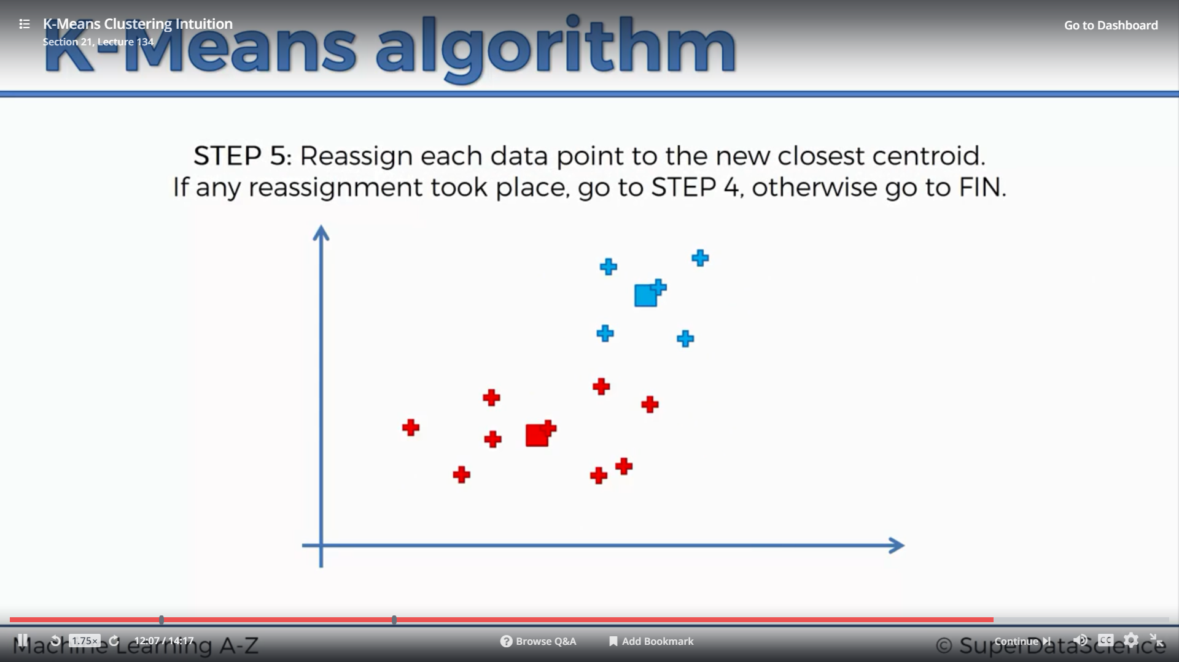
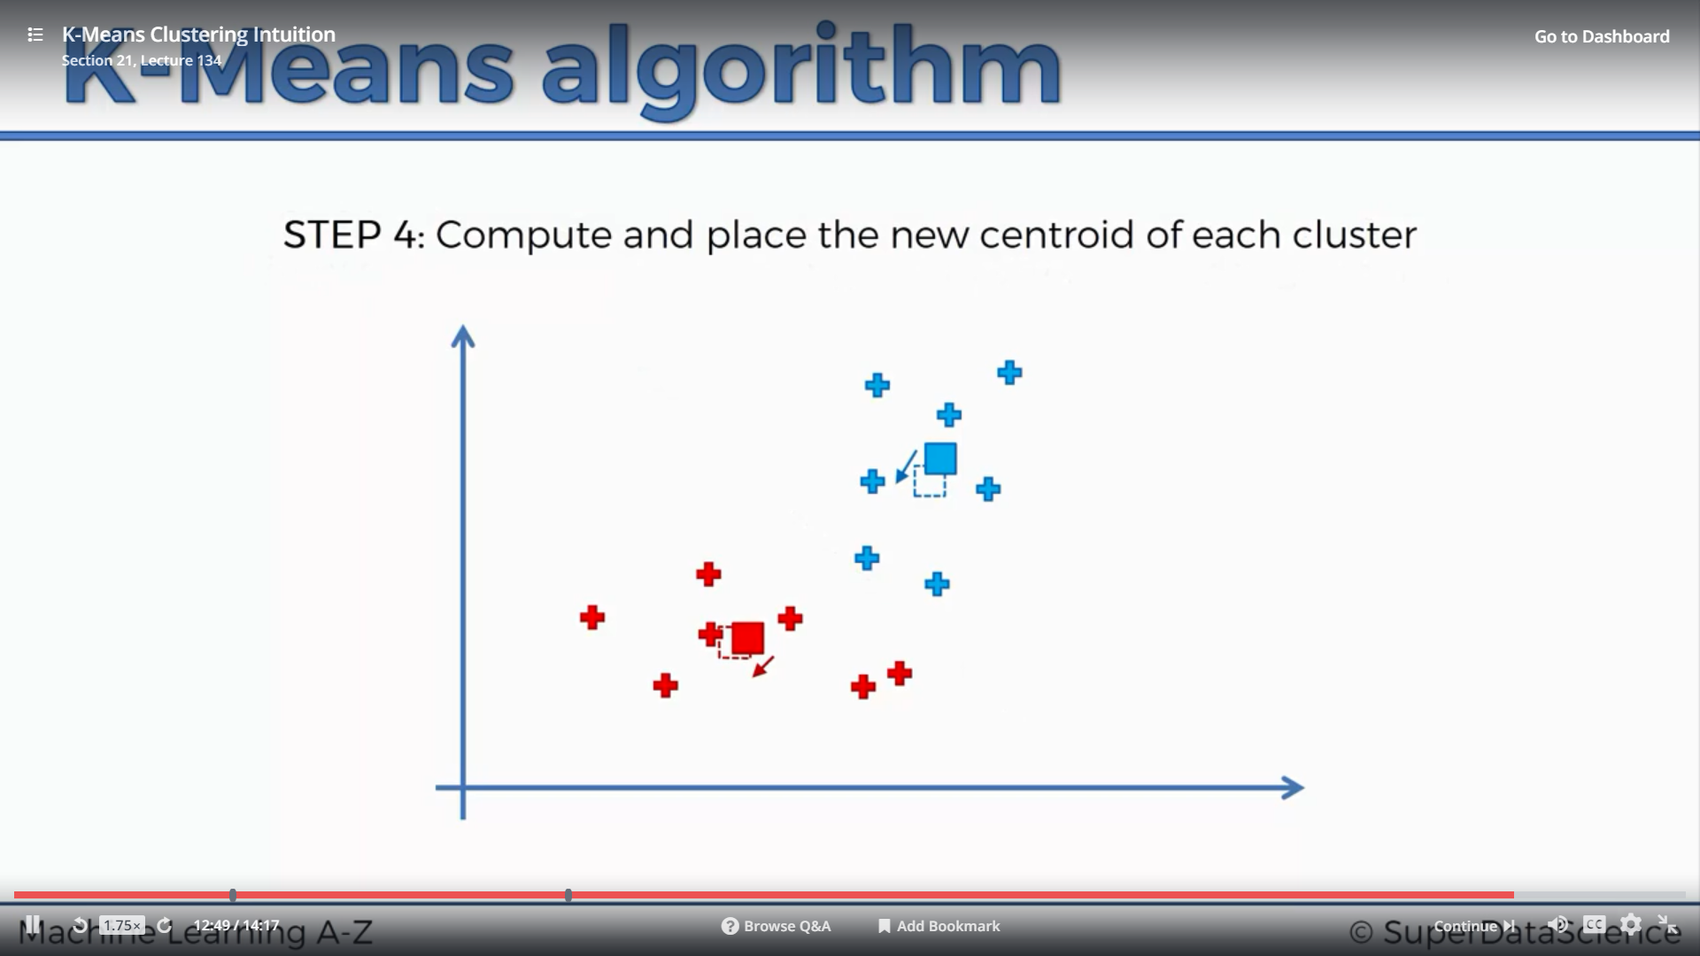
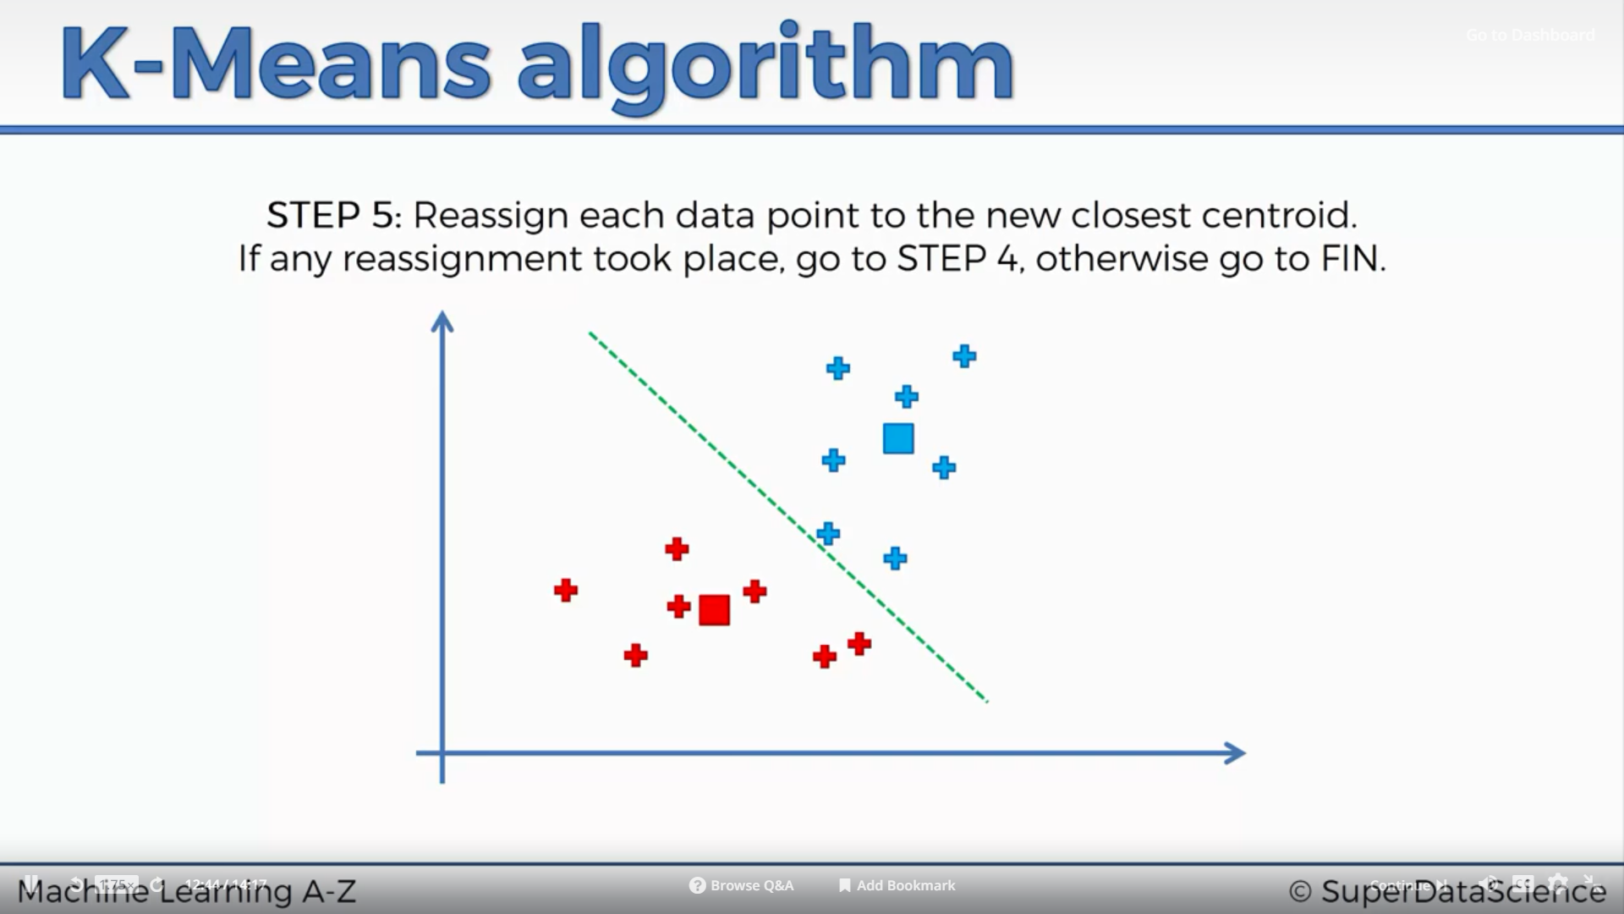
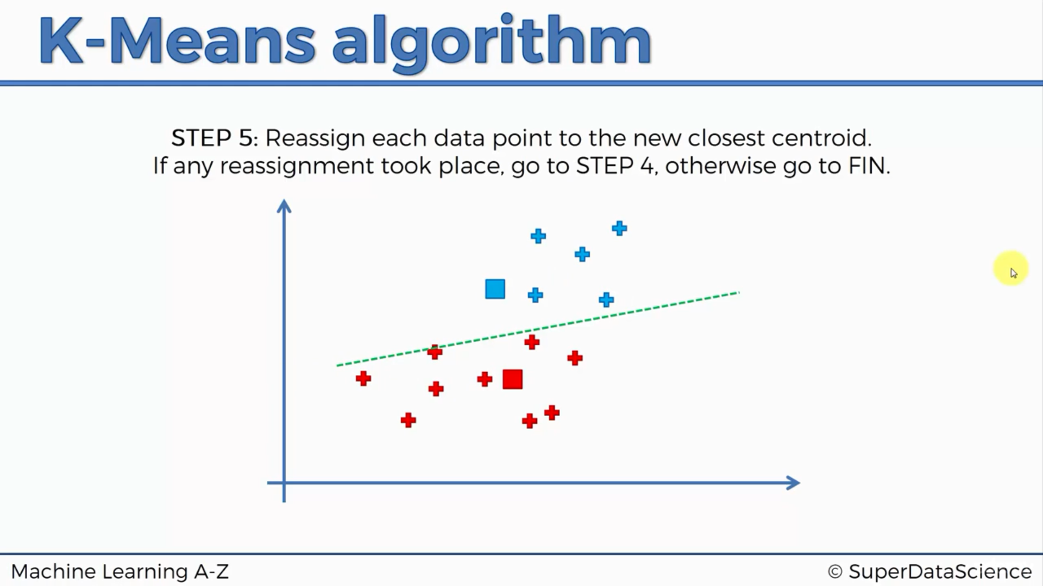
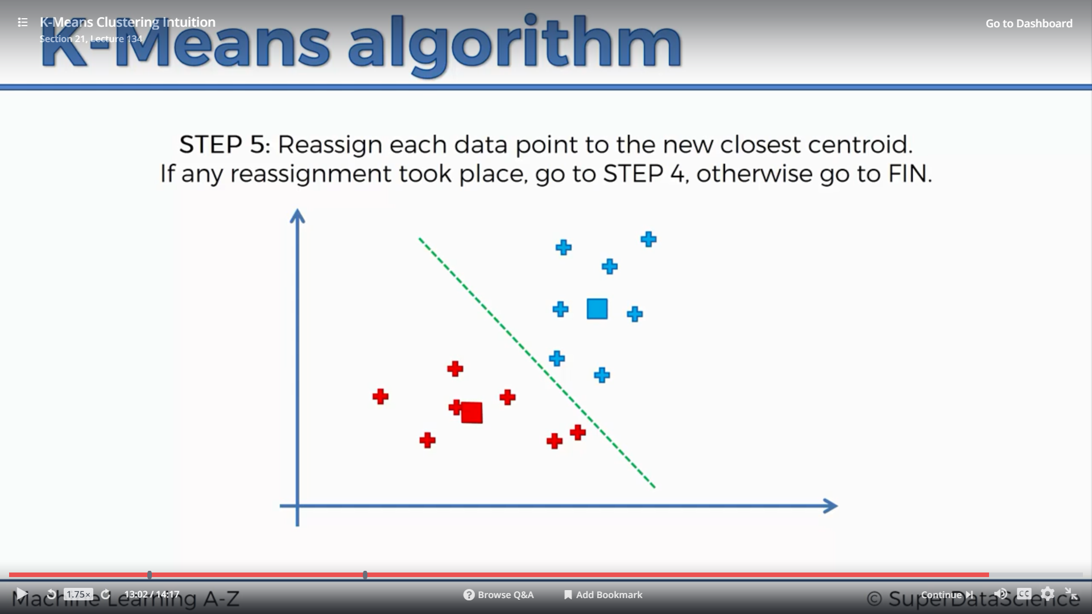
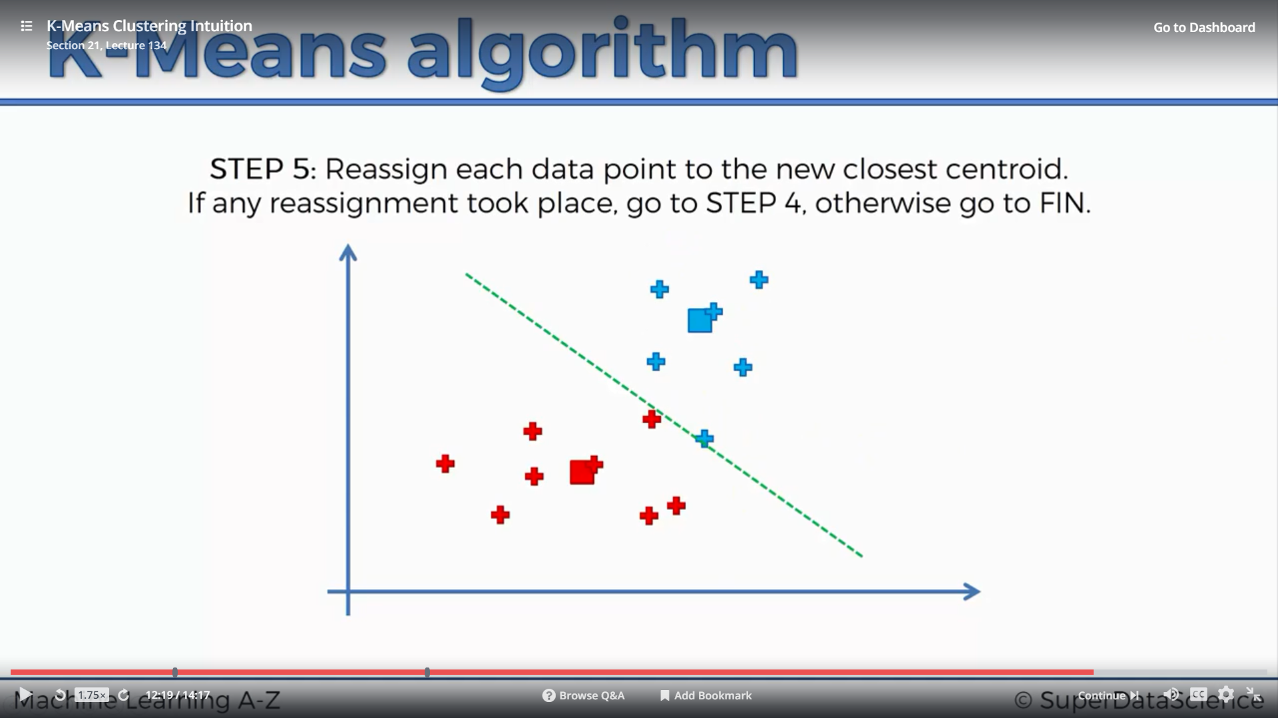
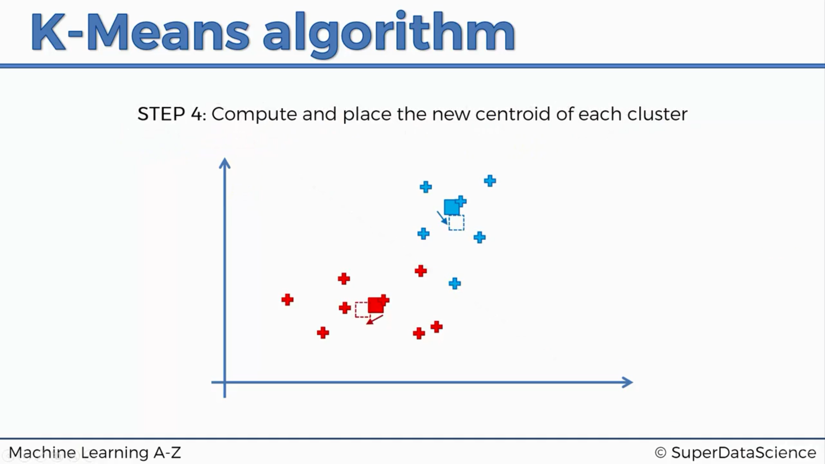
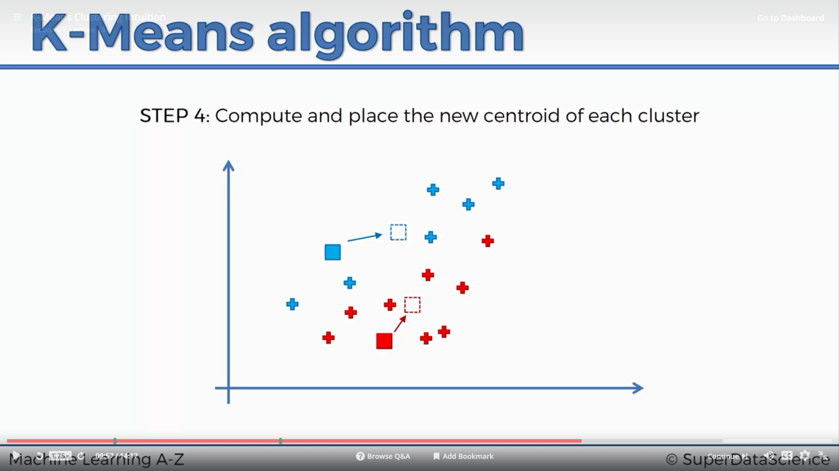

Slide 9
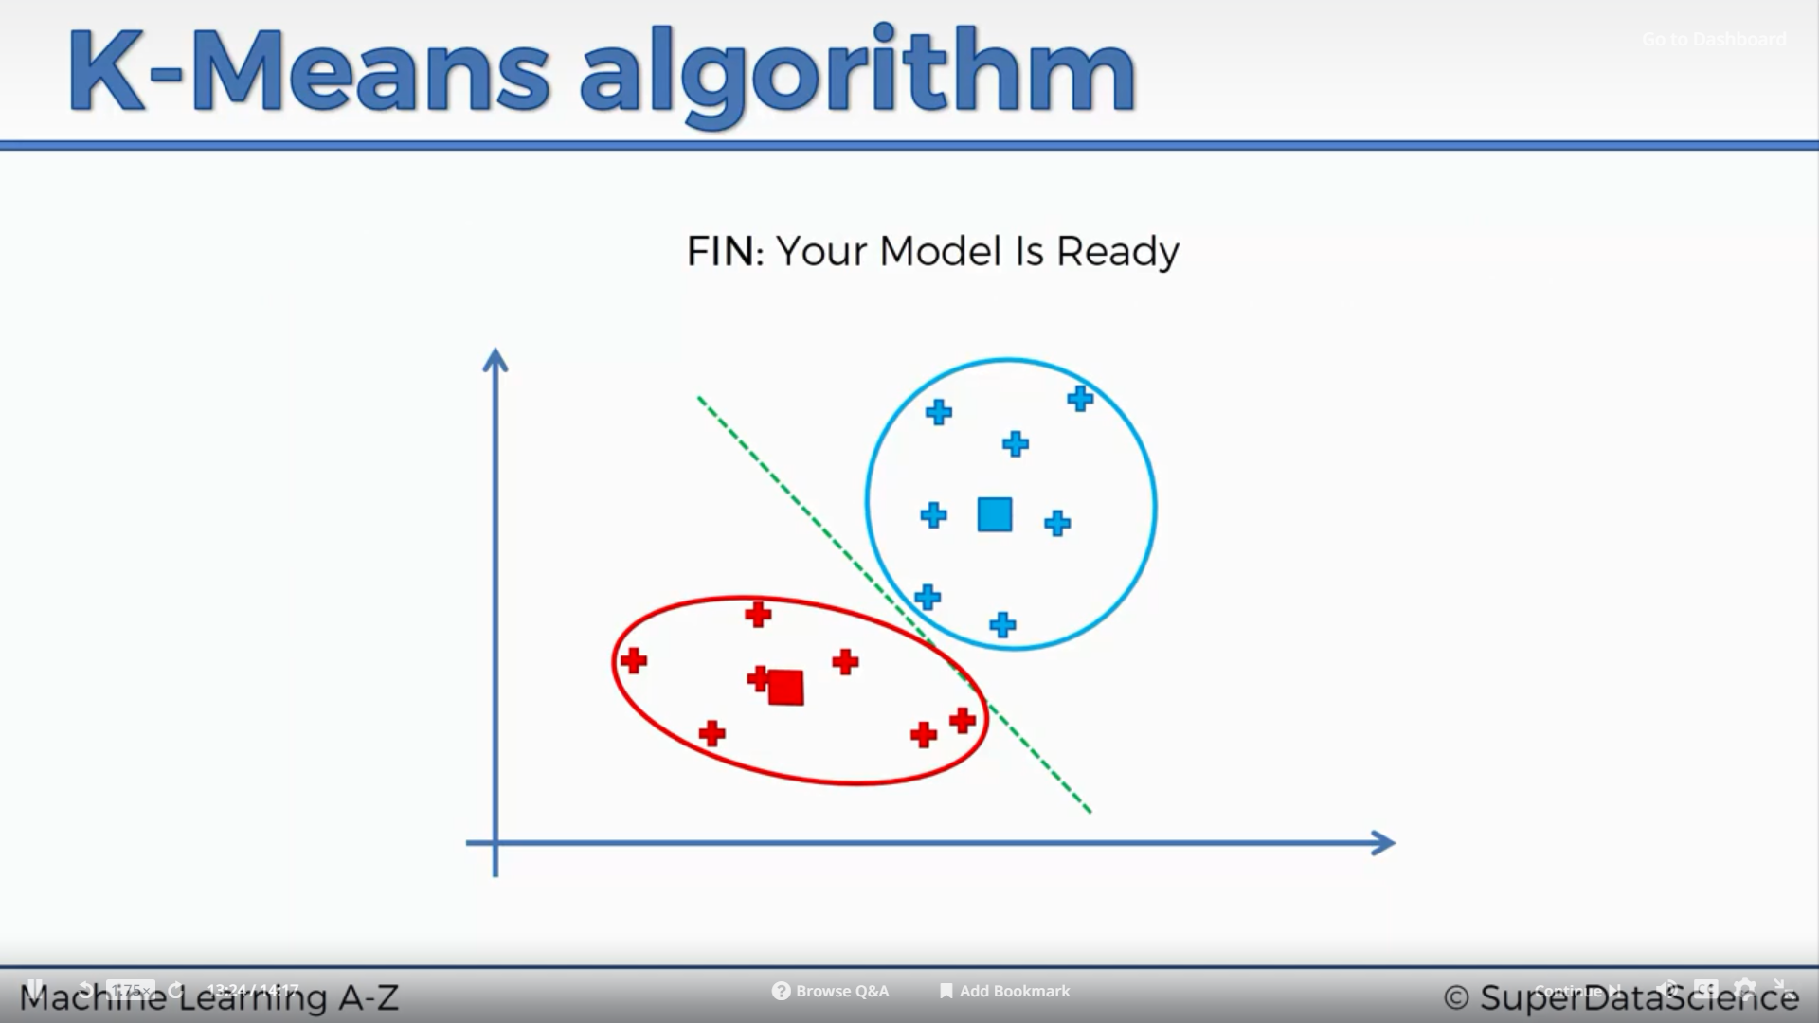
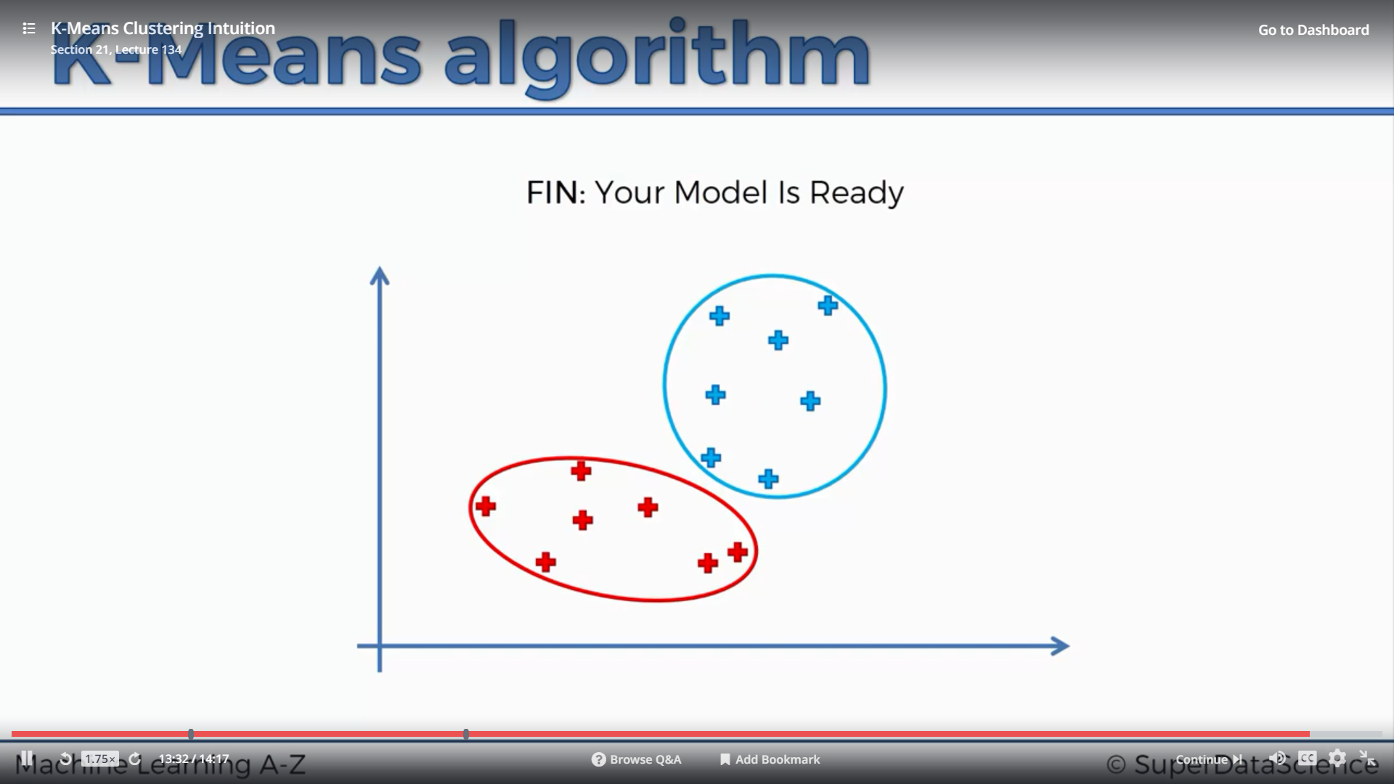

Slide 10
Random Initialization Trap

Slide 11
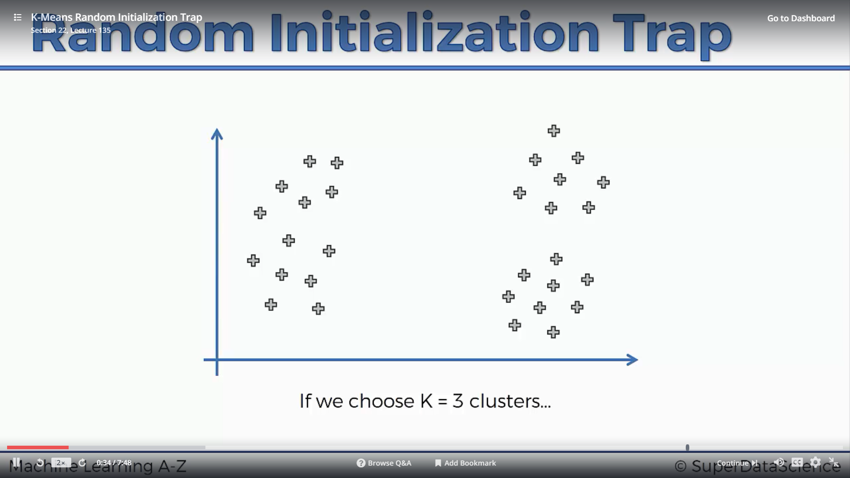
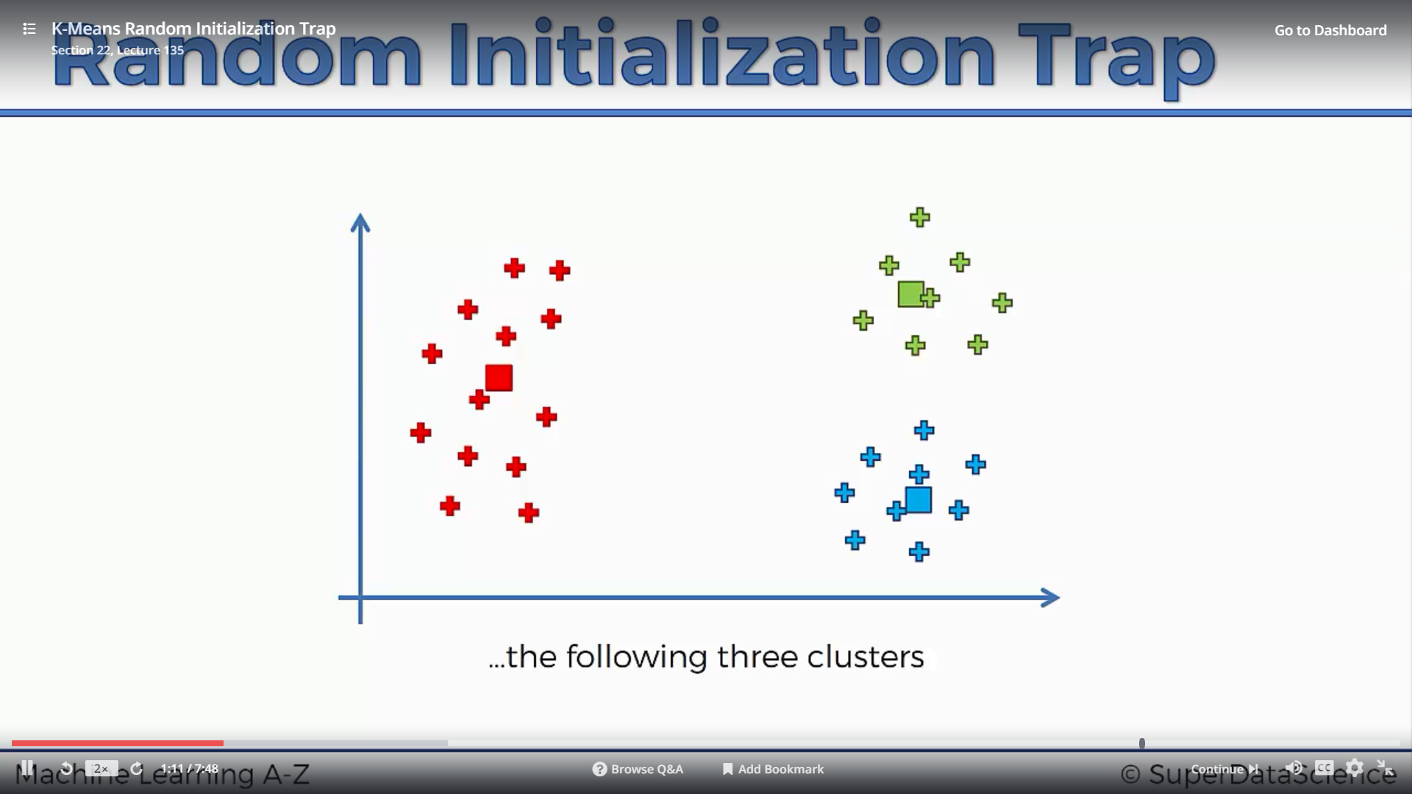
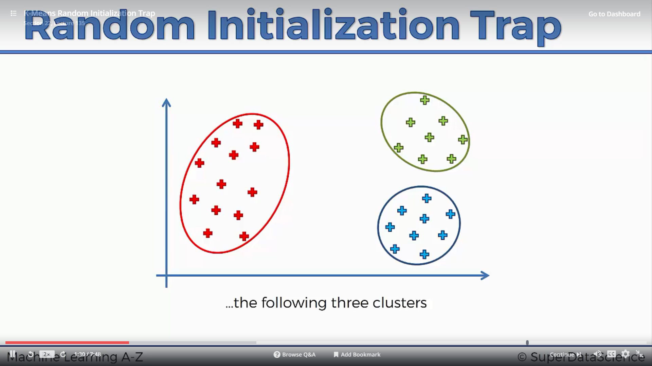

Slide 12
Steps to creating a K Means Cluster
STEP 1: Choose the number of clusters (K)
STEP 2: Randomly select K points, the centroids (not necessarily from your dataset)
STEP 3: Assign each data point to the closest centroid. This creates K clusters.
STEP 4: Compute and place the new centroid of each cluster
STEP 5: Reassign each data point to the new closest centroid. If any reassignments took place, go to STEP 4. Otherwise, go to FINISH
FINISH: The model is ready.

Slide 13
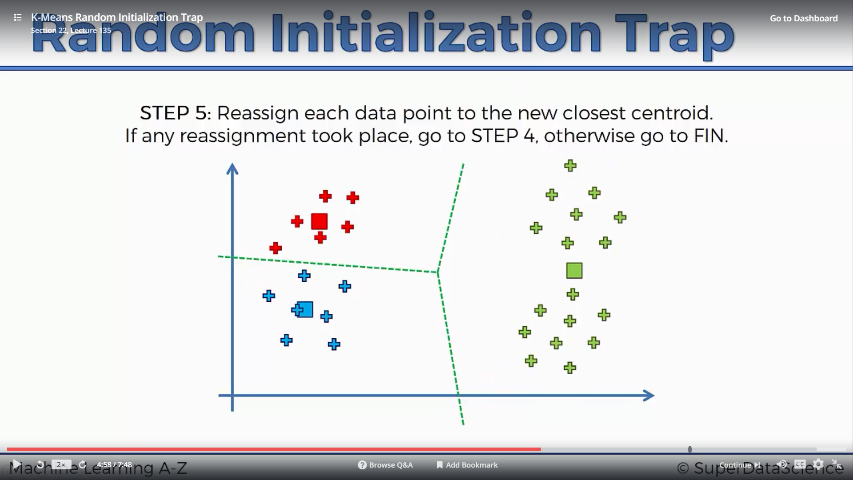
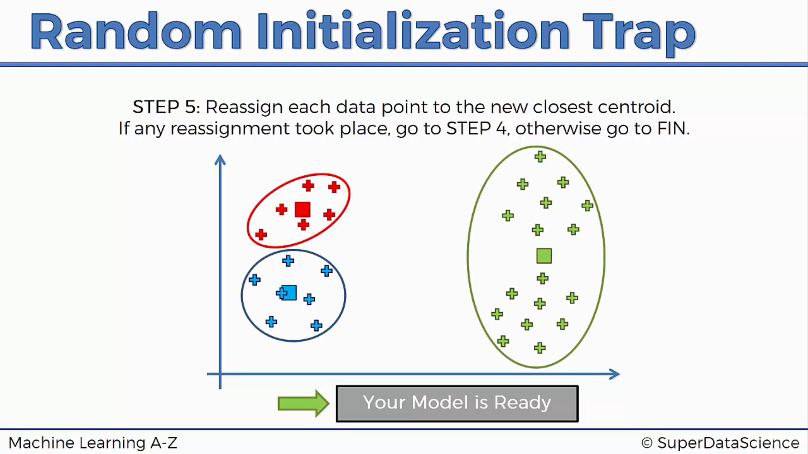
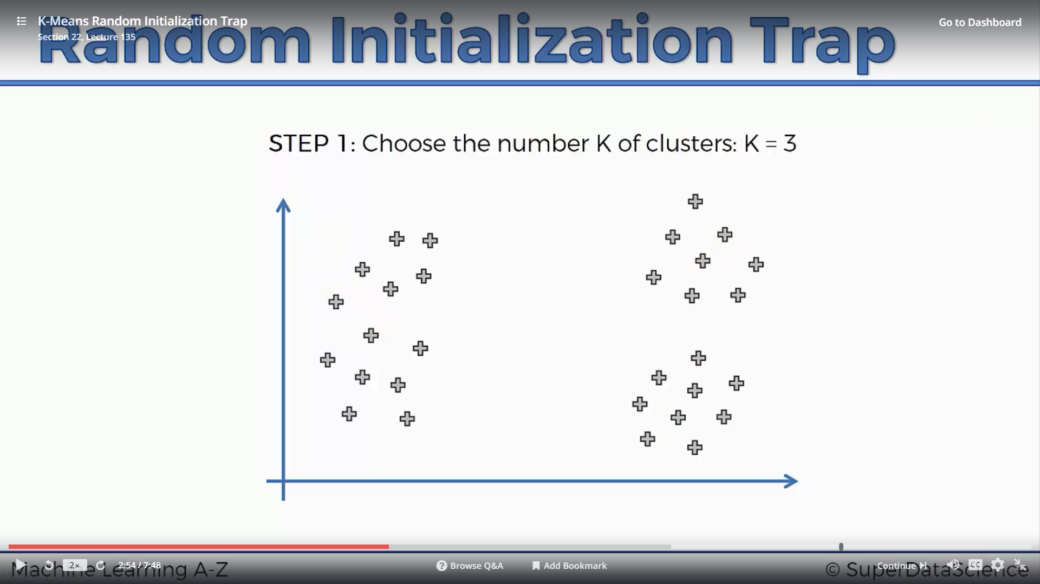
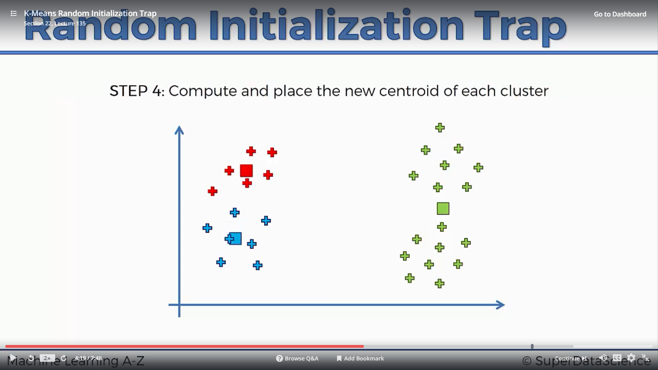
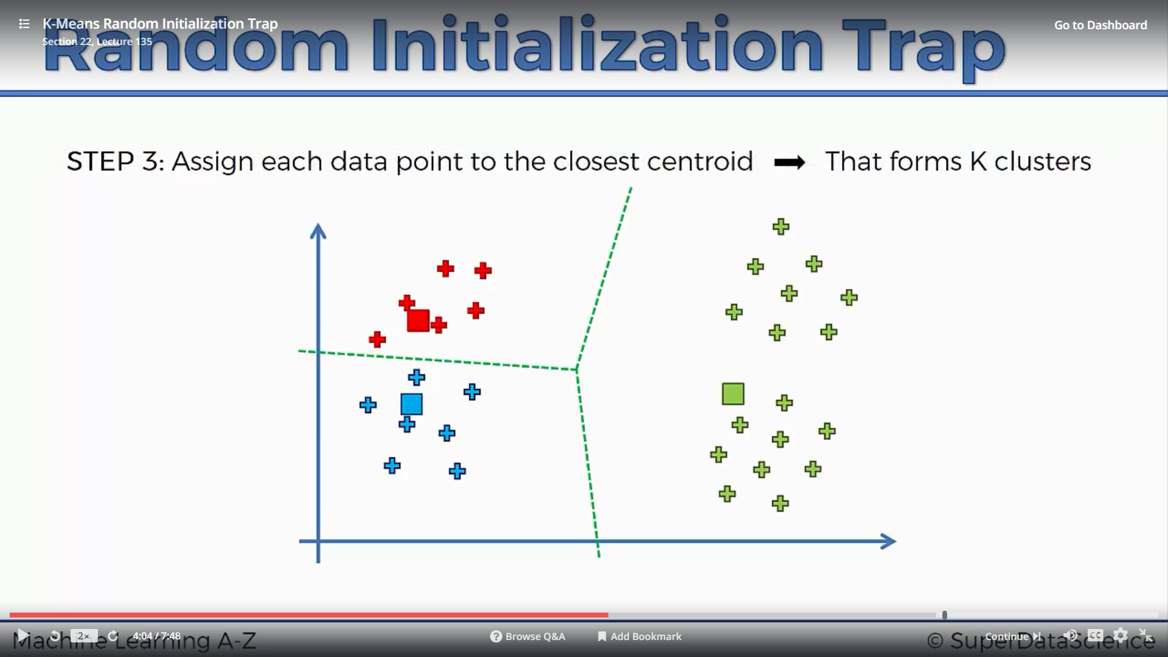
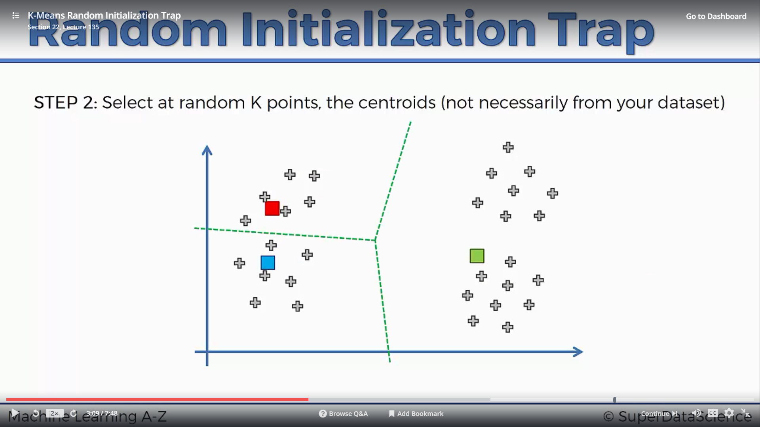
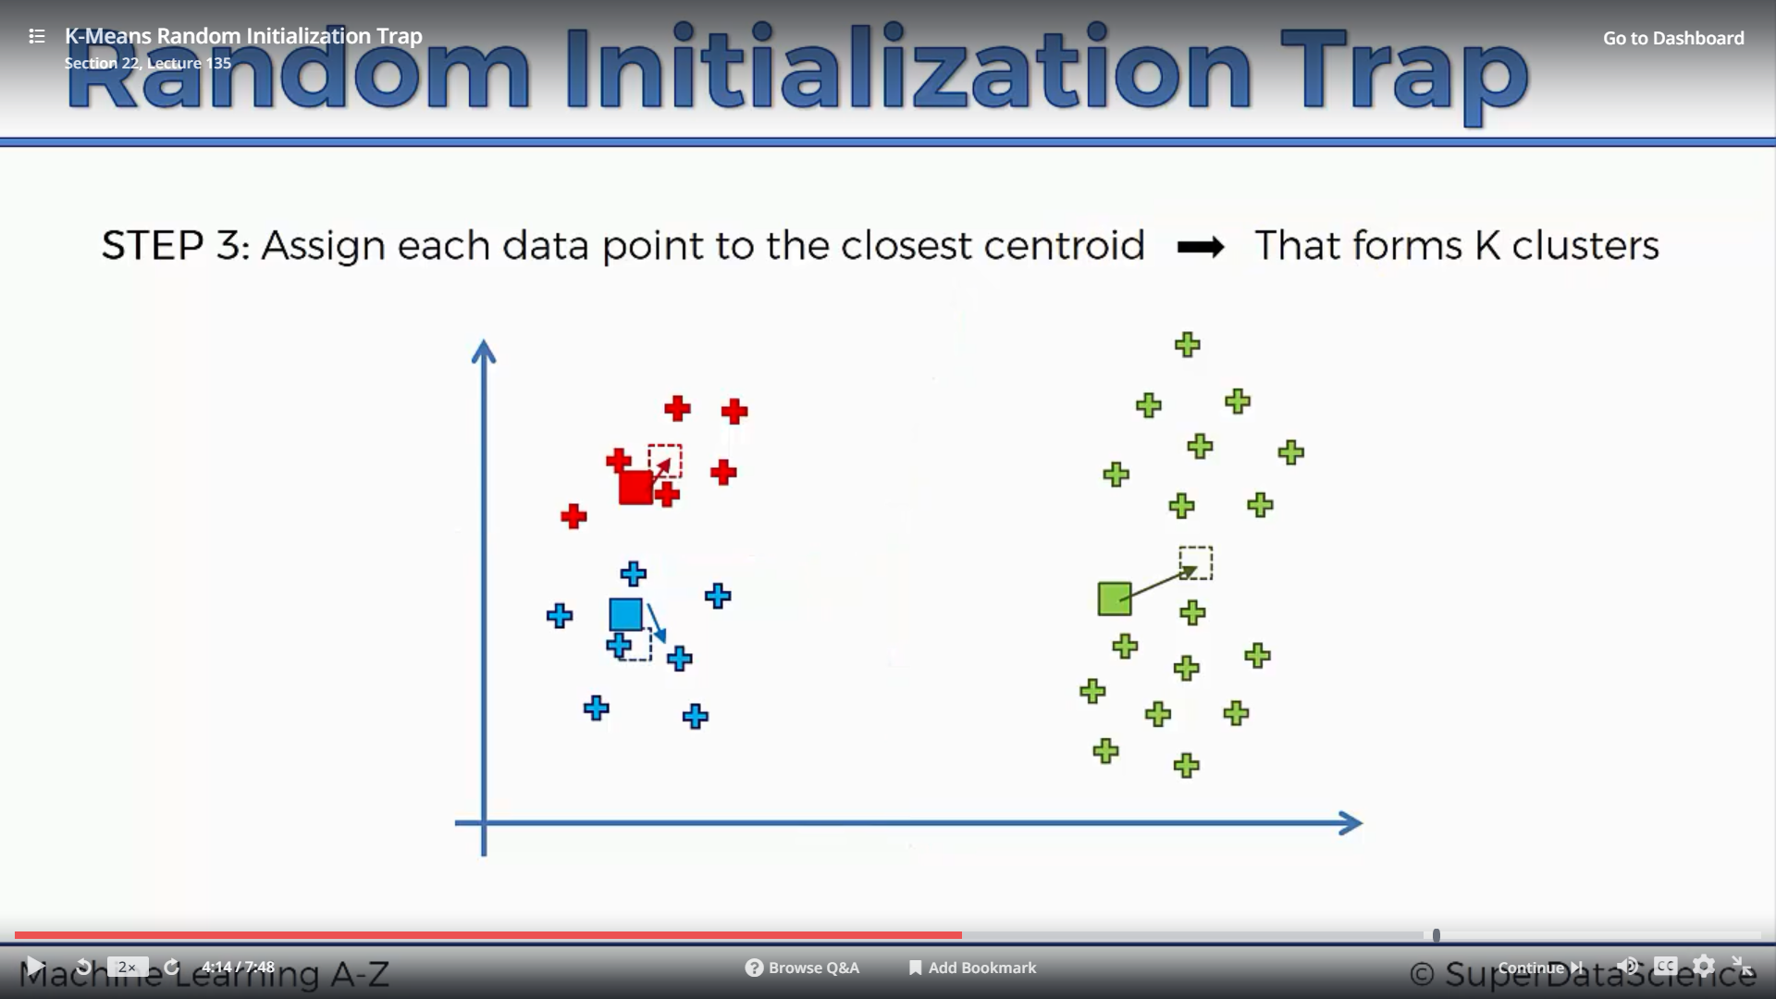

Slide 14
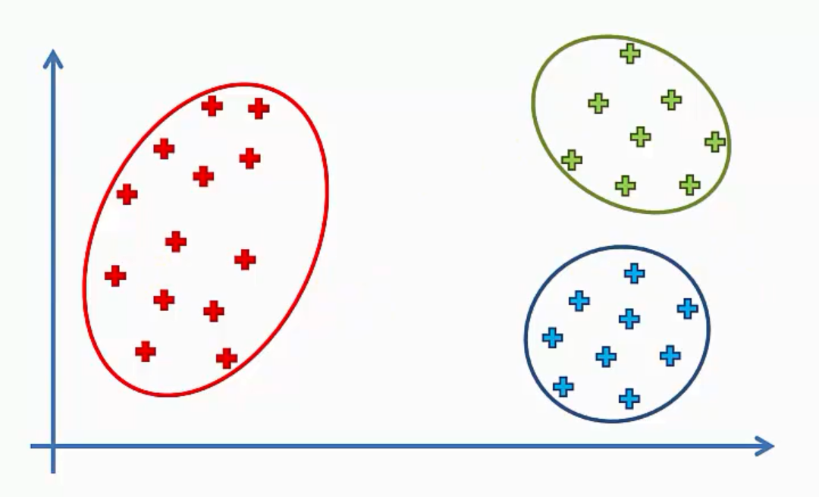
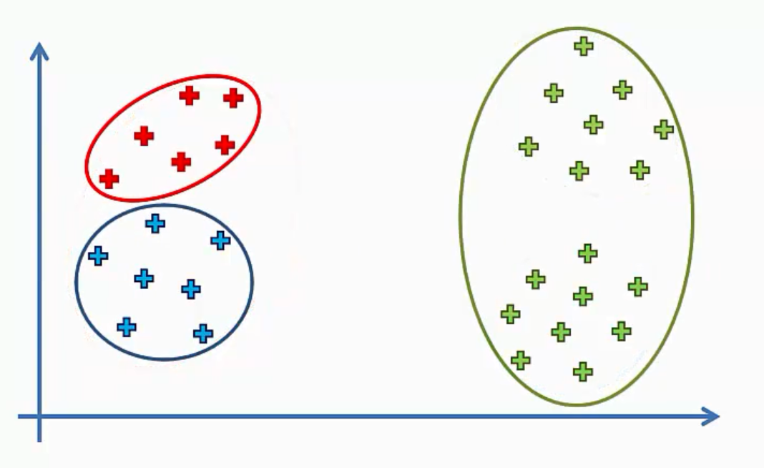

Slide 15
Choosing the number of clusters (K)

Slide 16
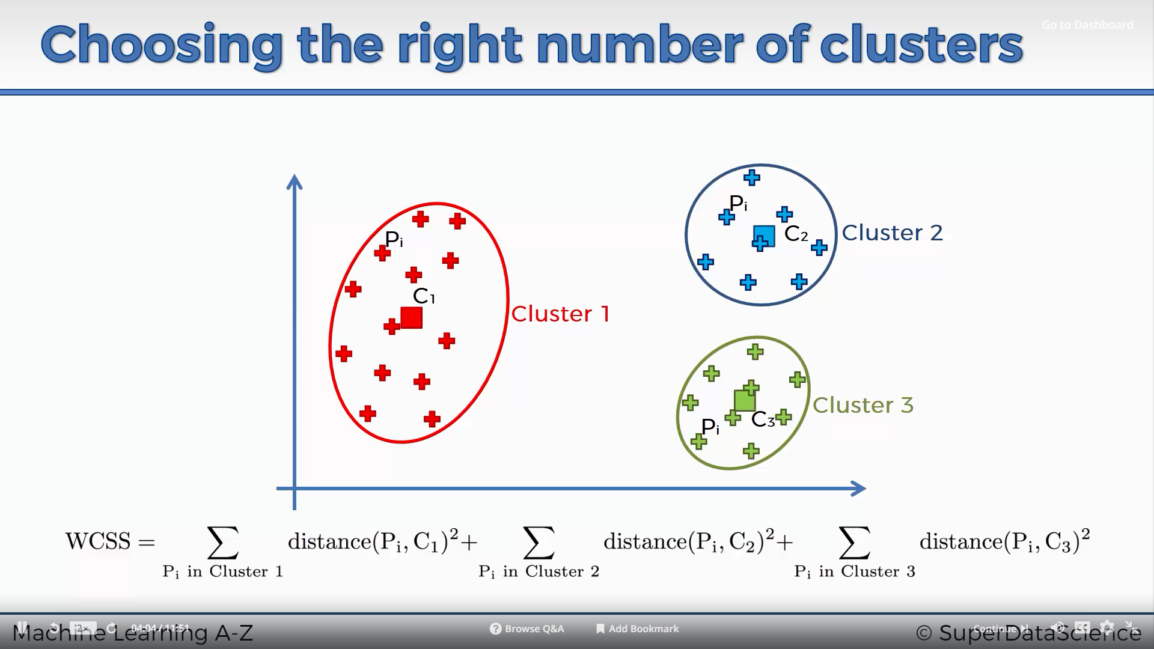
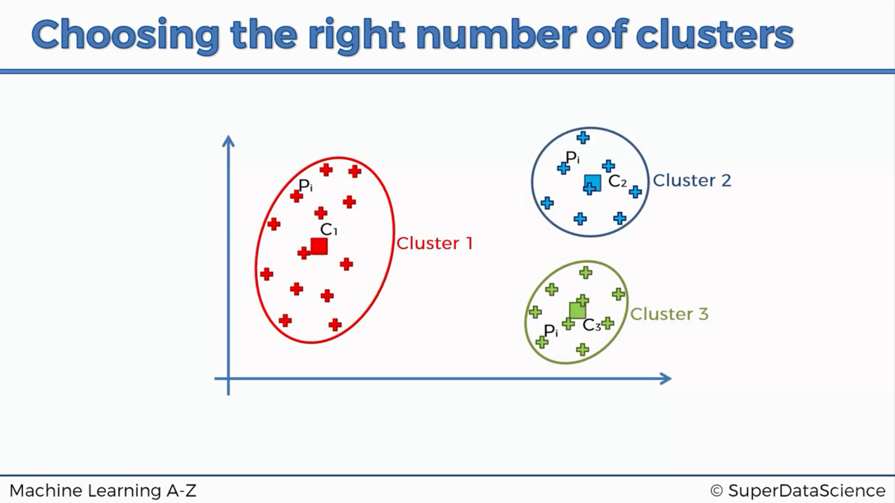
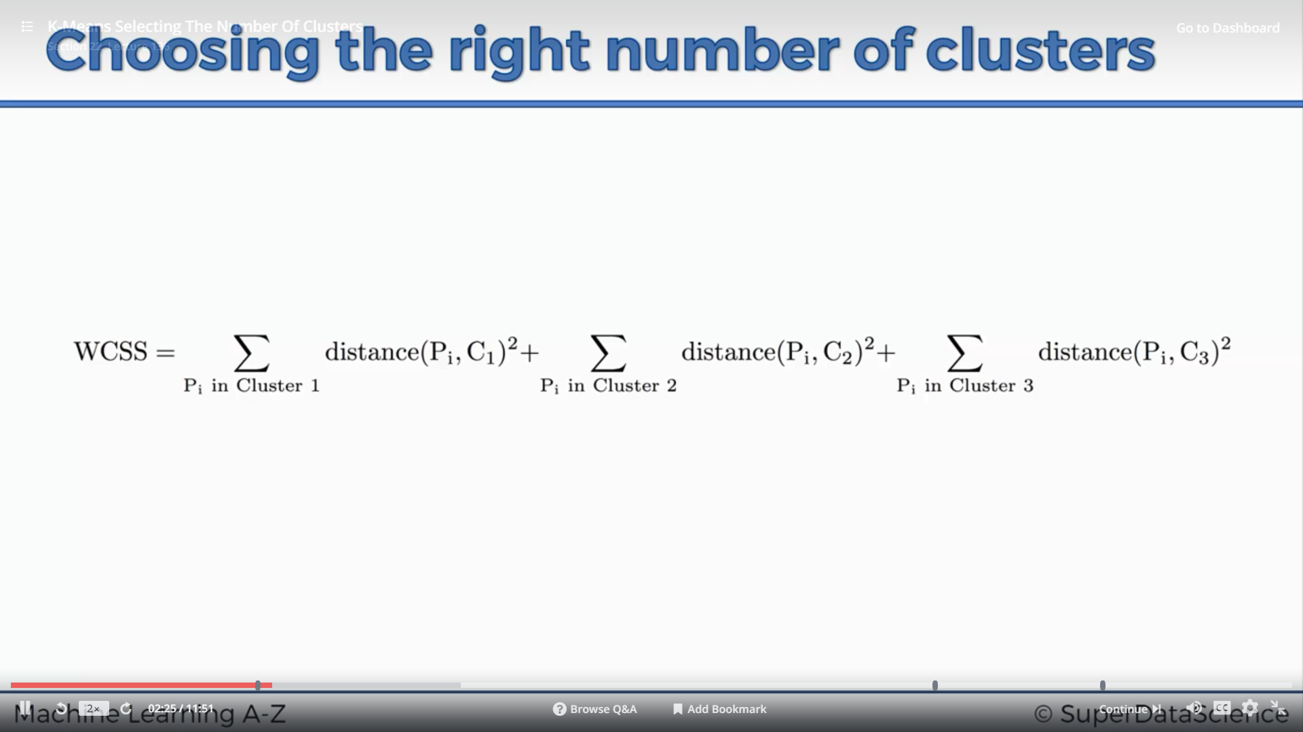
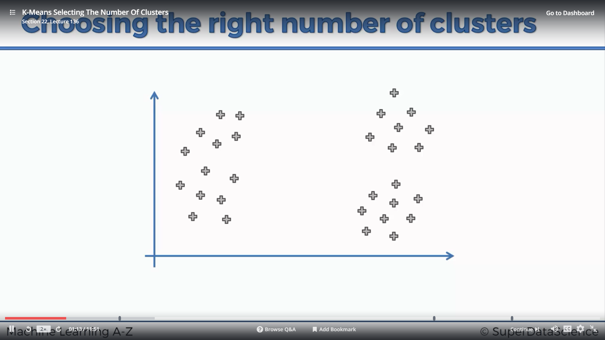

Slide 17
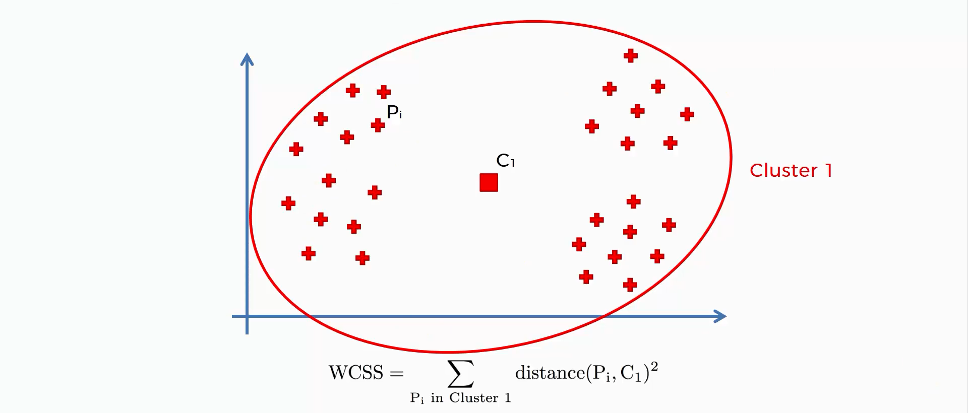

Slide 18
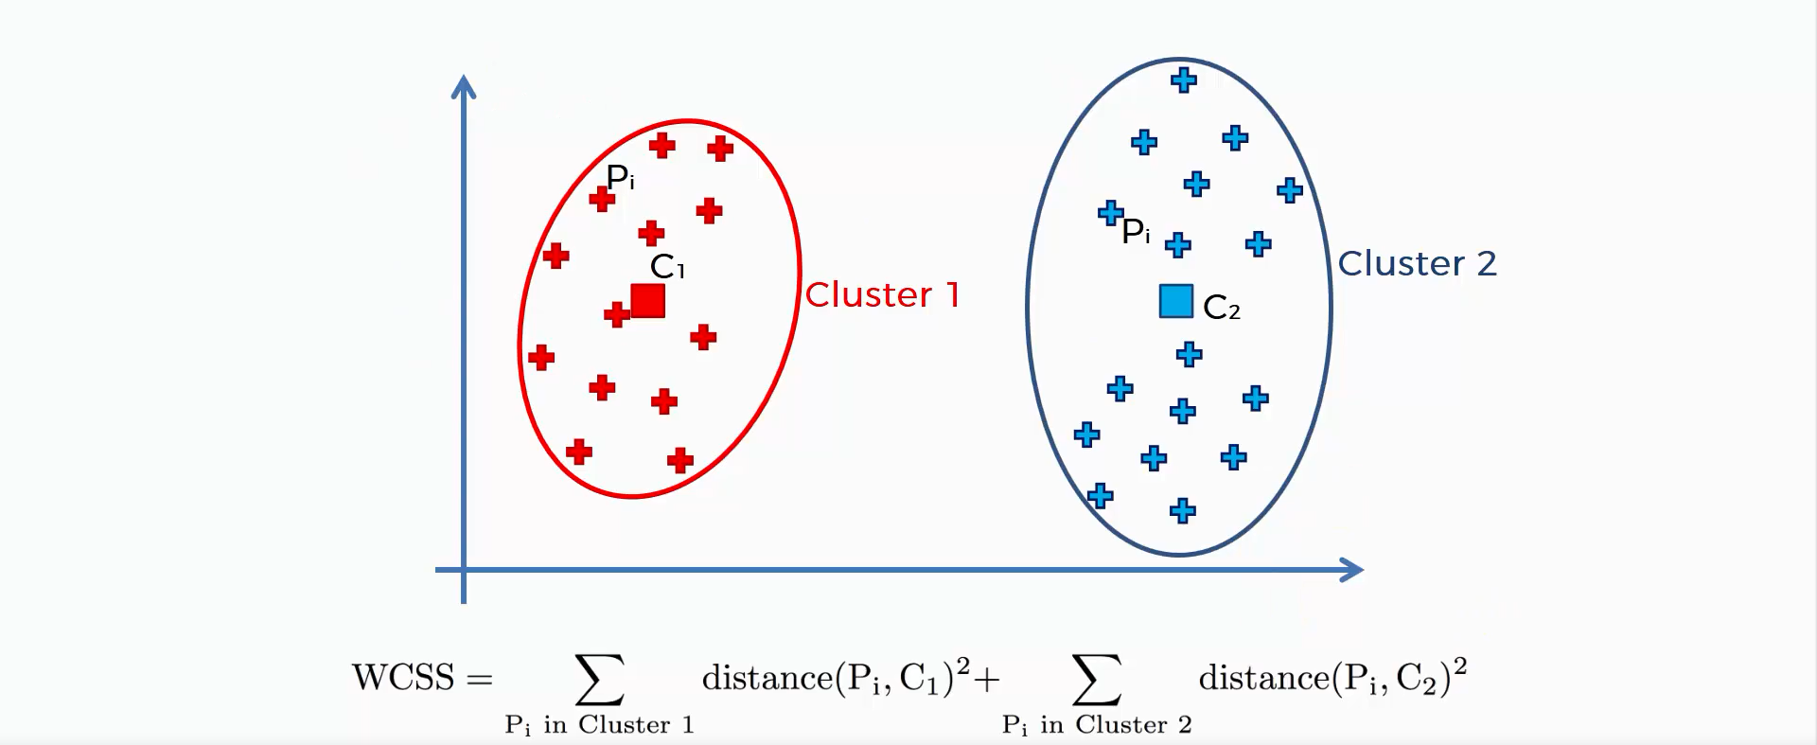

Slide 19
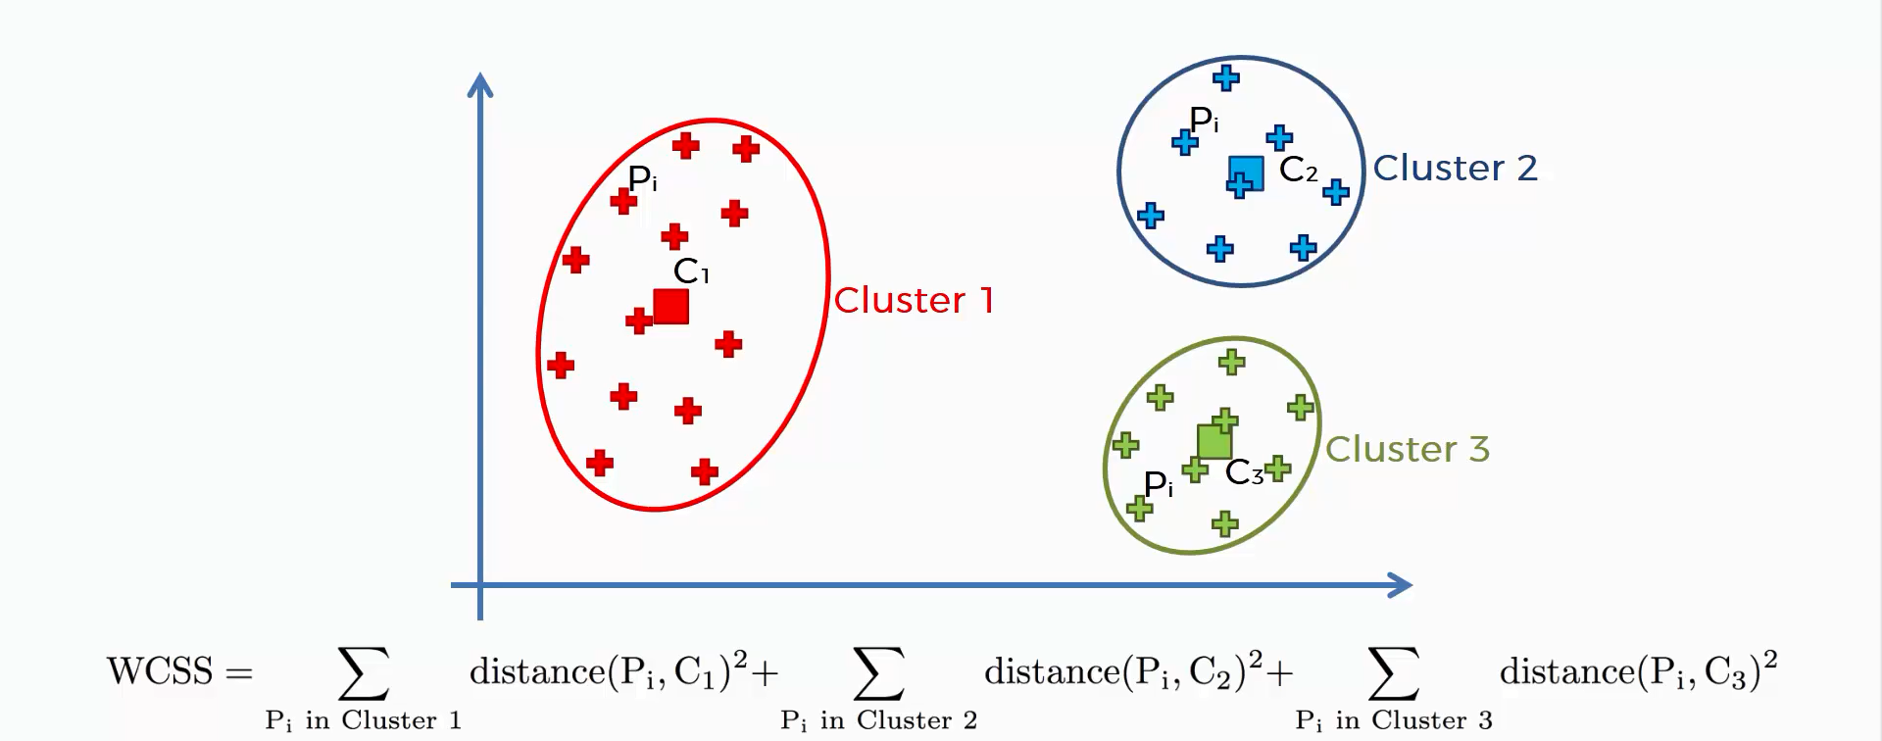

Slide 20
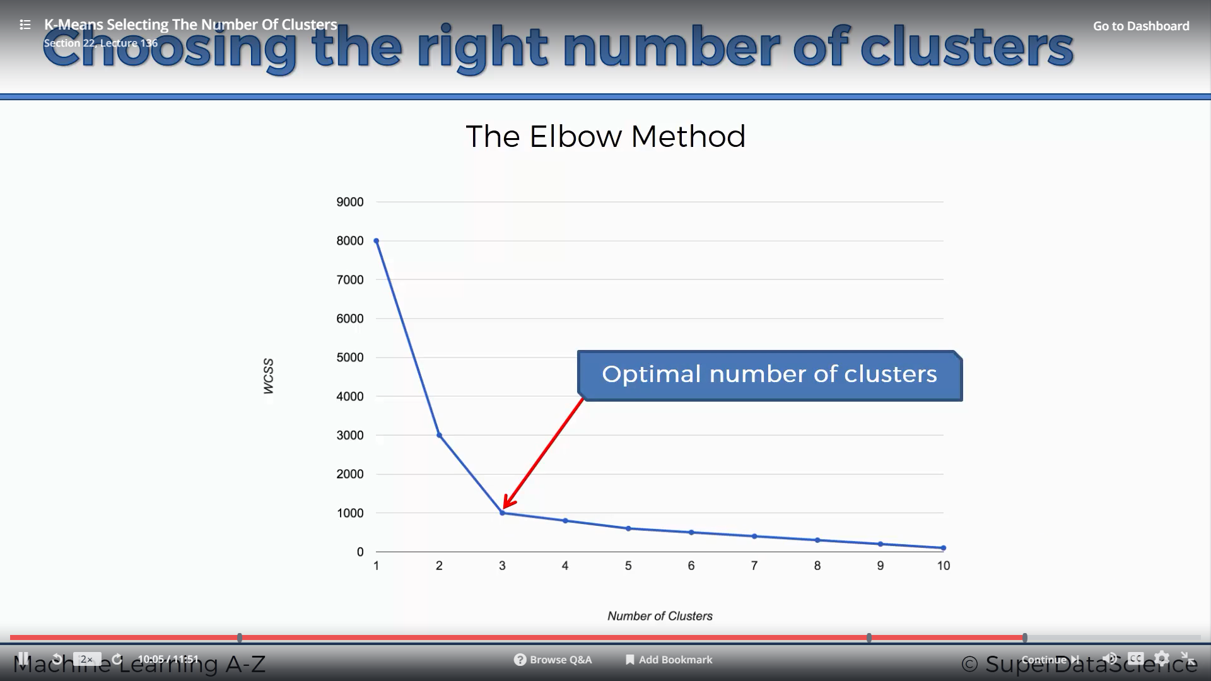
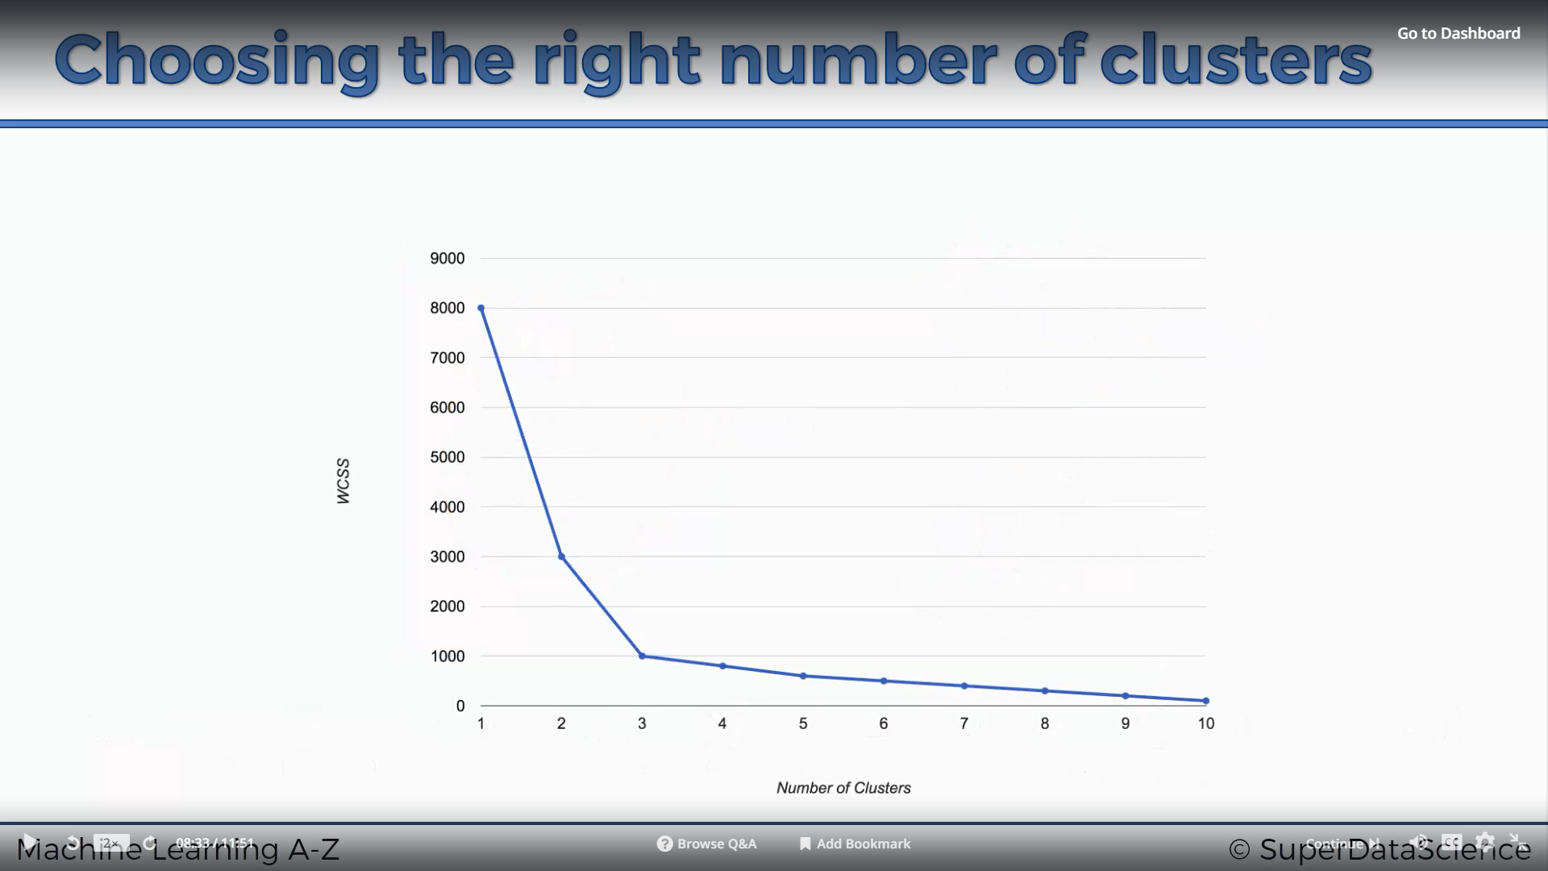

Slide 21
Caveats of K-Means
The globally optimal result may not be achieved

Slide 22
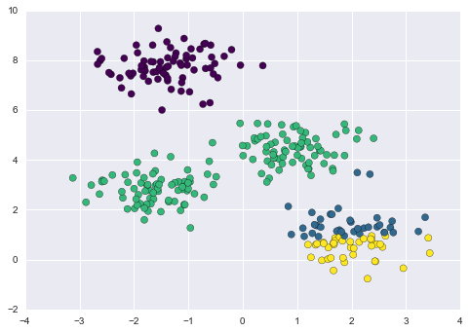

Slide 23
Caveats of K-Means
The globally optimal result may not be achieved
The number of clusters must be selected beforehand

Slide 24
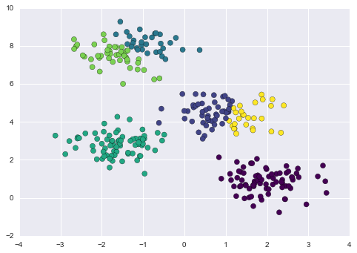

Slide 25
Caveats of K-Means
The globally optimal result may not be achieved
The number of clusters must be selected beforehand
k-means is limited to linear cluster boundaries

Slide 26
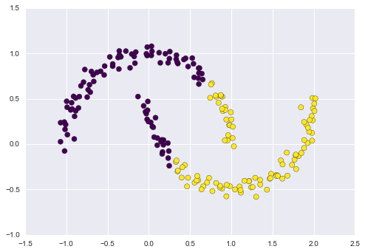

Slide 27
Caveats of K-Means
The globally optimal result may not be achieved
The number of clusters must be selected beforehand
k-means is limited to linear cluster boundaries
k-means can be slow for large numbers of samples

Slide 28
Kernel transformation to K Means
Spectral Clustering

Slide 29
Spectral Clustering
K Means is limited to linear cluster boundaries.
This situation is reminiscent of Support Vector Machines, where we used a kernel transformation to project the data into a higher dimension so that a linear separation became possible. We might imagine using the same trick to allow k-means to discover non-linear boundaries.
One version of this kernelized k-means is implemented in Scikit-Learn within the SpectralClustering estimator. It uses the graph of nearest neighbors to compute a higher-dimensional representation of the data, and then assigns labels using a k-means algorithm

Slide 30
